Slide 1

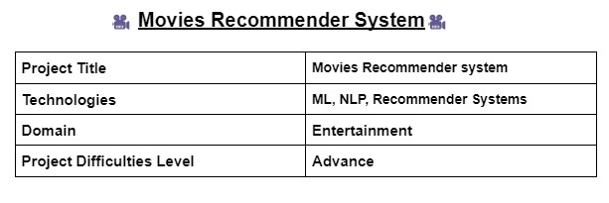
PROJECT BY KANAV’s WARRIORS

Slide 2
PROJECT CONTENTS
PROBLEM STATEMENT & OBJECTIVE
RECOMMENDER SYSTEMS
IMPACTS OF RECOMMENDER SYSTEMS
PROJECT ROADMAP
DATASET DESCRIPTION
DATA PREPROCESSING
EXPLORATORY DATA ANALYSIS
PLOTS AND INSIGHTS
LITERATURE SURVEY
TYPES OF RECOMMENDATION MODELS
MODEL SELECTION
WHY CONTENT BASED FILTERING???
SIMILARITY SCORE CALCULATION
RECOMMENDATION GENERATION
USER INTERFACE DEVELOPMENT
MODEL DEPLOYMENT & TESTING
CHALLENGES FACED
FUTURE SCOPE

Slide 3
PROBLEM STATEMENT
Using different techniques of Machine Learning, we need to build a Recommender System
That recommends movies based on “Cast, Genre, Reviews, TMDB/IMDB ratings”.
OBJECTIVE
The objective of the movie recommender system project is to develop a system that provides personalized movie recommendations to users based on their preferences and past behavior.
The main goals of the project include:
Improve User Experience
Increase User Engagement
Enhance Movie Discovery
Foster User Satisfaction
Improve Recommendation Accuracy
Develop an Intuitive User Interface
Deploy a Functional Recommender System

Slide 4
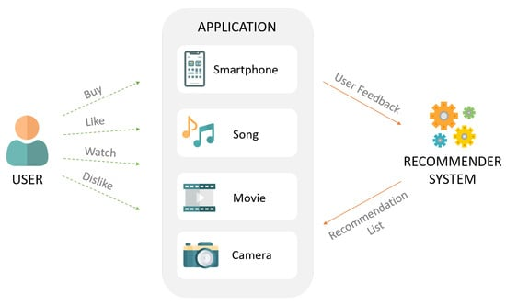
RECOMMENDER SYSTEMS
Recommendation systems, or recommender systems, are software engines designed to suggest items to users depending on previous likes and dislikes, product engagement and interaction, etc.
Recommendation engines provide a personalized user experience, by helping every single consumer identify and discover their favorite movies, TV shows, digital products, books, articles, services, and more.

Slide 5
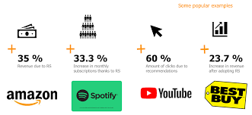
IMPACTS OF RECOMMENDATION SYSTEMS
AMAZON: 35% of the purchases on Amazon are the result of their recommender system, according to McKinsey.
ALIBABA: During the Chinese global shopping festival of November 11, 2016, Alibaba achieved growth of up to 20% of their conversion rate using personalized landing pages, according to Alizila.
YOUTUBE: Recommendations are responsible for 70% of the time people spend watching videos on YouTube.
NETFLIX: 75% of what people are watching on Netflix comes from recommendations, according to McKinsey

Slide 6
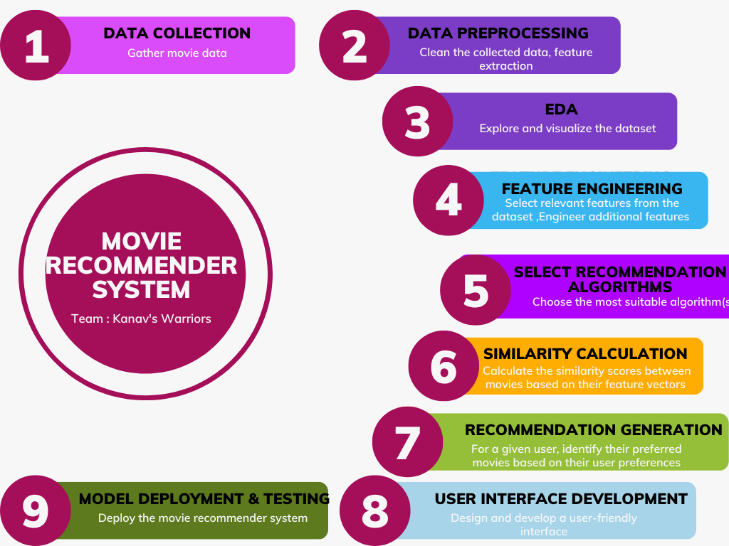
PROJECT ROADMAP

Slide 7
DATASET DESCRIPTION
This dataset consists of the following files:
movies_metadata.csv: The main Movies Metadata file. Contains information on 45,000 movies featured in the Full Movie Lens dataset. Features include title, homepage , budget, revenue, release dates, languages etc.
keywords.csv: Contains the movie plot keywords for our Movie Lens movies. Available in the form of a stringified
JSON Object.
credits.csv: Consists of Cast and Crew Information for all our movies. Available in the form of a stringified JSON Object.
links_small.csv: Contains the TMDB and IMDB IDs of a small subset of 9,000 movies of the Full Dataset.
ratings_small.csv: The subset of 100,000 ratings from 700 users on 9,000 movies.

Slide 8
DATA PRE-PROCESSING
For pre-processing, connect the data access from various files.
Perform data cleaning tasks to handle missing values, duplicates, and inconsistencies.
Apply text preprocessing techniques like lowercasing, tokenization, and removing stop words.
Transform the dataset into a format that recommendation engines can understand.

Slide 9
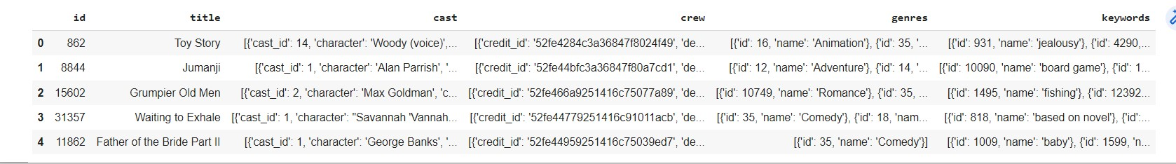
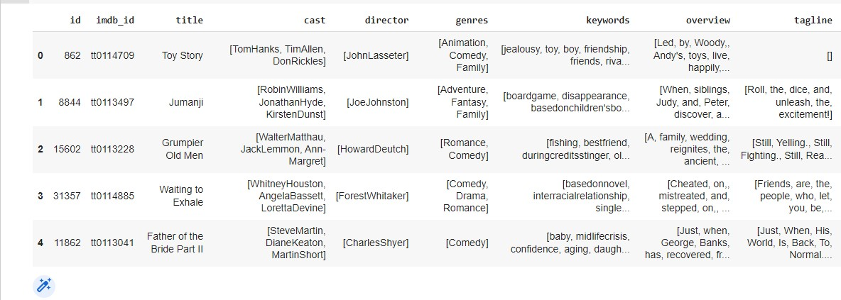
SNIPPET BEFORE PRE_PROCESSING DATA
SNIPPET AFTER PRE_PROCESSING DATA

Slide 10
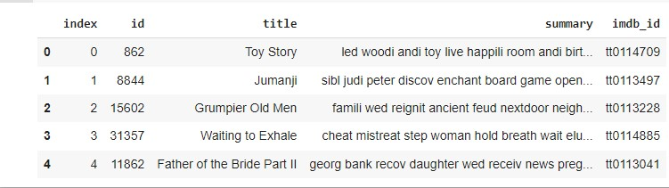
PRE_PROCESSED FINAL DATASET FOR MODEL TRAINING

Slide 11
LITERATURE SURVEY
MOVREC is a movie recommendation system presented by D.K. Yadav et al. based on collaborative filtering approach. Collaborative filtering makes use of information provided by user. That information is analysed, and a movie is recommended to the users which are arranged with the movie with highest rating first.
Luis M Capos et al has analyzed two traditional recommender systems i.e., content based filtering and collaborative filtering. As both have their own drawbacks, he proposed a new system which is a combination of Bayesian network and collaborative filtering.
A hybrid system has been presented by Harpreet Kaur et al. The system uses a mix of content as well as collaborative filtering algorithm. The context of the movies is also considered while recommending. The user - user relationship as well as user - item relationship plays a role in the recommendation.
The user specific information or item specific information is clubbed to form a cluster by Utkarsh Gupta et al. using chameleon. This is an efficient technique based on Hierarchical clustering for recommender system. To predict the rating of an item voting system is used. The proposed system has lower error and has better clustering of similar items.

Slide 12
EXPLORATORY DATA ANALYSIS (EDA)
All the features of the new Data frame were analysed and visualized using visualization techniques.
Python libraries like MATPLOTLIB and SEABORN was used for this purpose.
Univariate, Bivariate and Multivariate analysis was done to understand the data and to draw meaningful insights from the data.

Slide 13
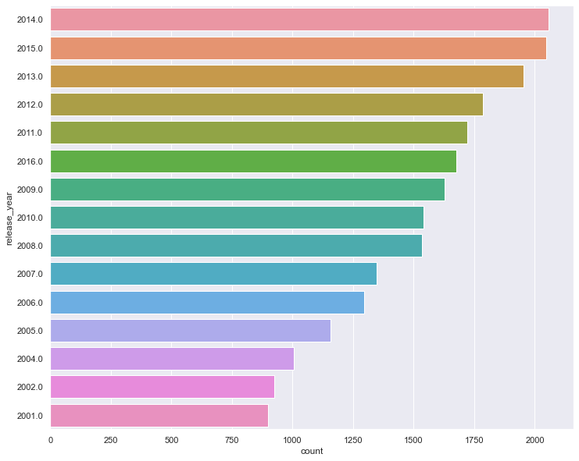
PLOTS AND INSIGHTS
DISTRIBUTION OF MOVIES BASED ON YEAR
Based on the graph *2014* is the year when most of the movies were released
Also *2001* is the year when lease number of movies were released.

Slide 14
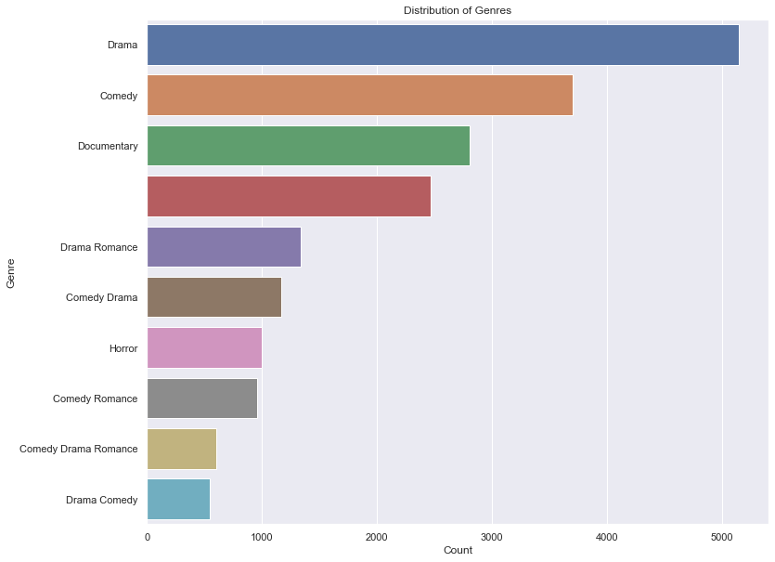
DISTRIBUTION OF MOVIES BASED ON GENRES
Based on the graph above, we can conclude Most movies were released based on the DRAMA GENRE
The lease popular option was DRAMA COMEDY GENRE

Slide 15
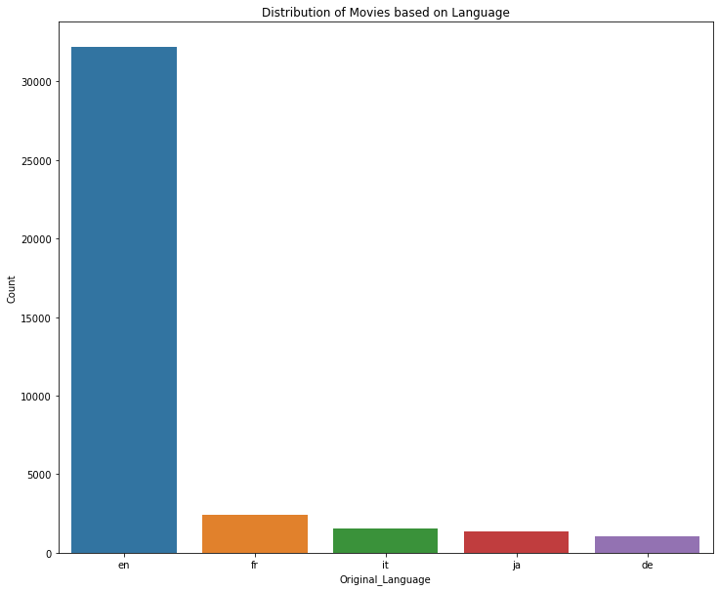
DISTRIBUTION OF MOVIES BASED ON LANGUAGE
Based on the graph above, we can conclude Most movies were released in the English Language compared to any other languages.

Slide 16
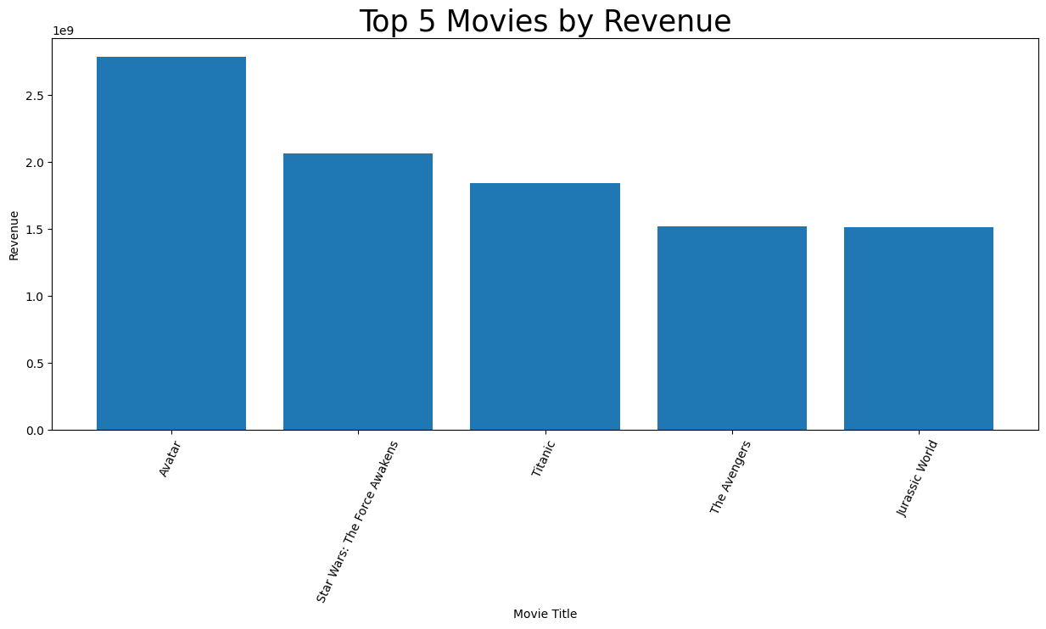
TOP 5 MOVIES BASED ON REVENUE
Based on the graph above, the movie “AVATAR” tops any movie in terms of Revenue collected in the box office

Slide 17
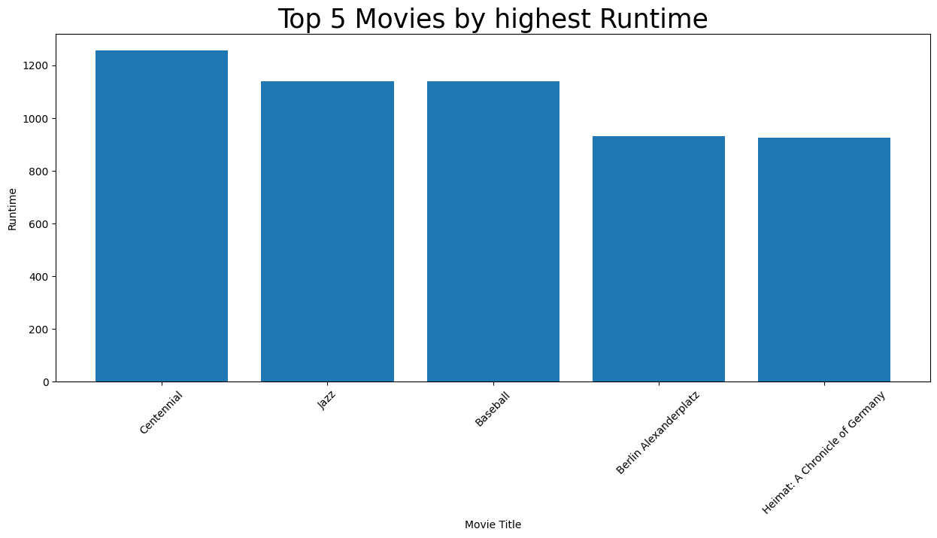
TOP 5 MOVIES BASED ON HIGHEST RUNTIME
Based on the graph above, the “Centennial” Miniseries was one of the longest and most ambitious television projects attempted at the time according to Google sources.

Slide 18
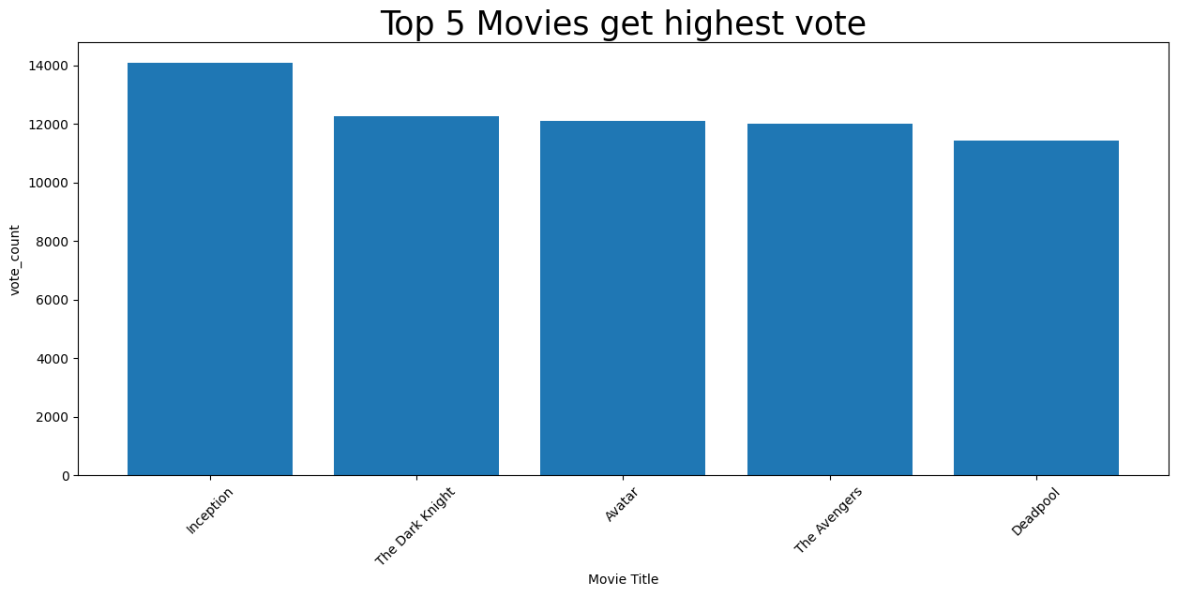
TOP 5 MOVIES BASED ON HIGHEST VOTECOUNT
Based on the graph above, the “INCEPTION” movie tops the list in terms of highest vote provided by the users.

Slide 19
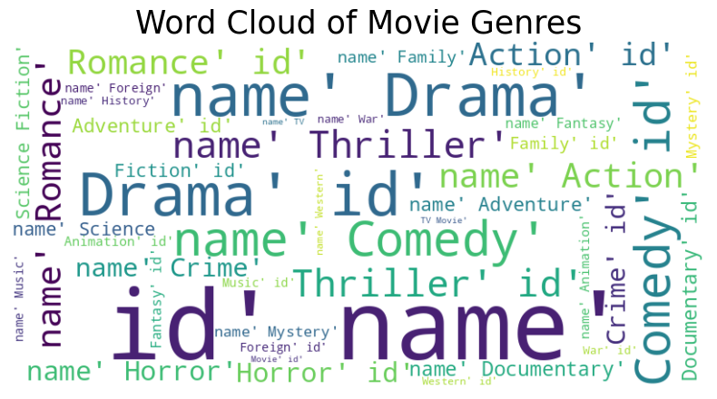
WORDCLOUD BASED ON MOVIE GENRES
A word cloud is a visual representation (image) of word data. In other words, it is a collection, or cluster, of words depicted in different sizes. The bigger and bolder the word appears, the more often it's mentioned within a given text and the more important it is.

Slide 20
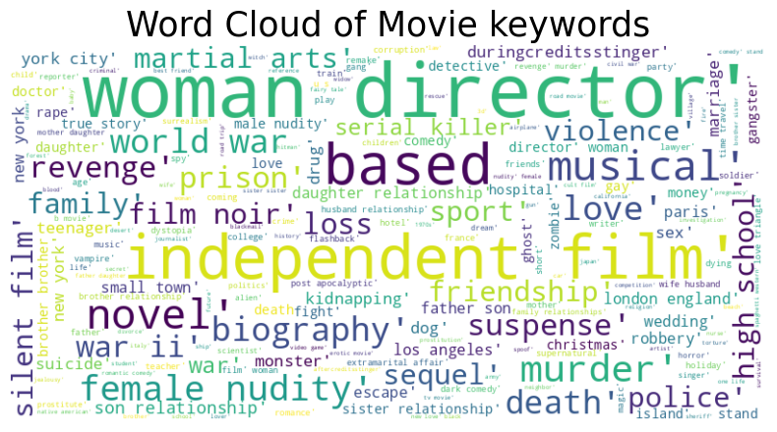
WORDCLOUD BASED ON MOVIE KEYWORDS

Slide 21
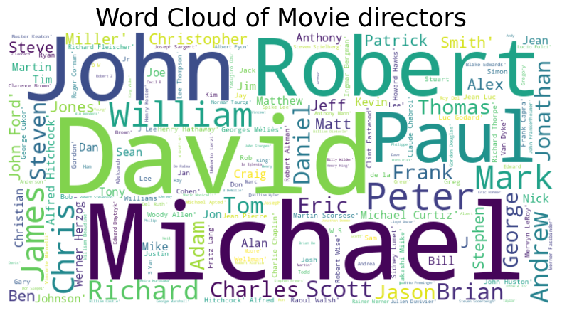
WORDCLOUD BASED ON MOVIE DIRECTORS

Slide 22
TYPES OF RECOMMENDATION MODELS
CONTENT – BASED TECHNIQUES
COLLABORATIVE FILTERING
HYBRID TECHNIQUES

Slide 23
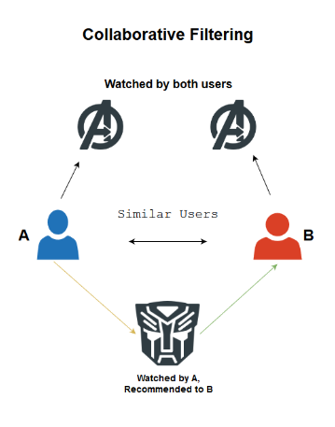
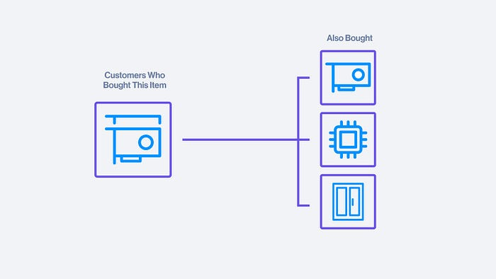
COLLABORATIVE FILTERING
The collaborative filtering method focuses on the similarity between different users and items.
There are two types of collaborative filtering:
a. User-Based Collaborative Filtering: Find similar users, recommend movies they enjoyed but target user hasn't seen.
b. Item-Based Collaborative Filtering: Identify similar movies based on user ratings, recommend similar items to target user's rated/watched movies.

Slide 24
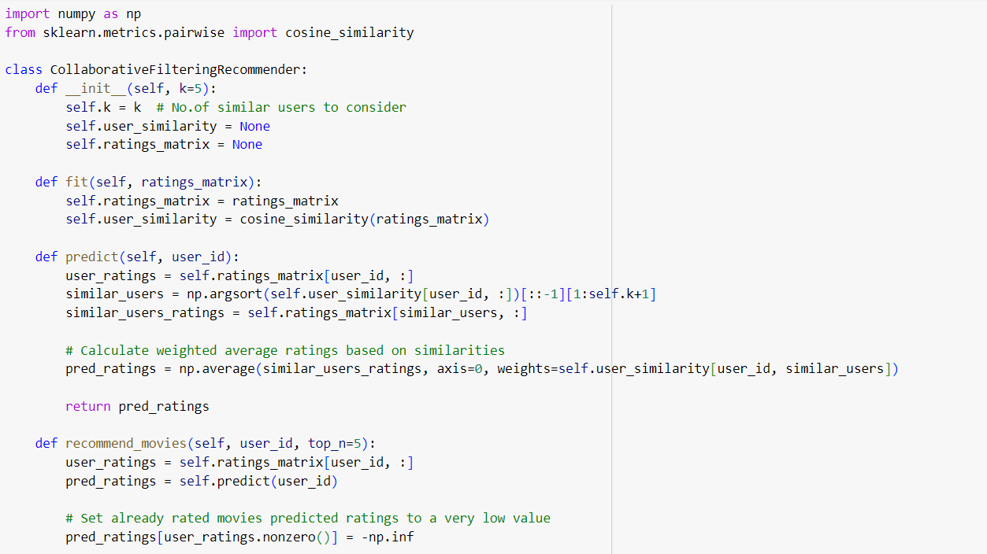
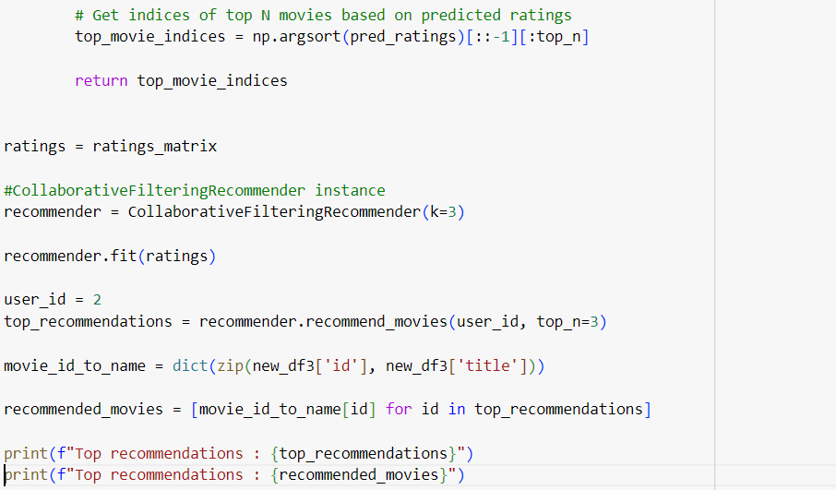
CODE SNIPPETS OF COLLABORATIVE FILTERING

Slide 25
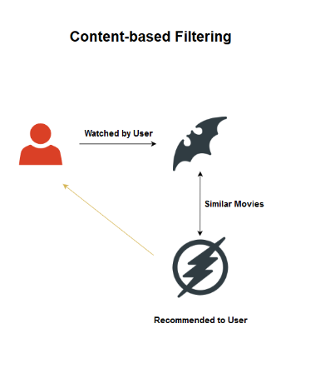
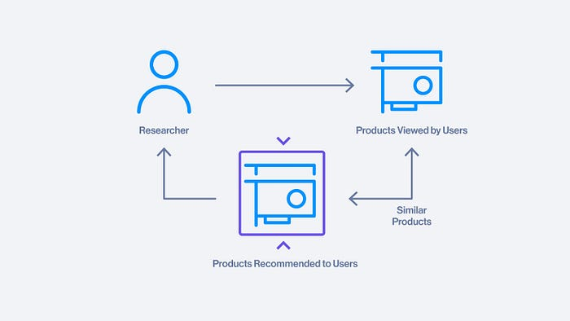
CONTENT BASED FILTERING
This approach recommends movies based on the similarity of their content..
The recommendation system will suggest products with similar classifications to the user previously interacted with.
For example, if the last three watched movies included the comedy genre, the system will recommend other similar comedy movies or shows.

Slide 26
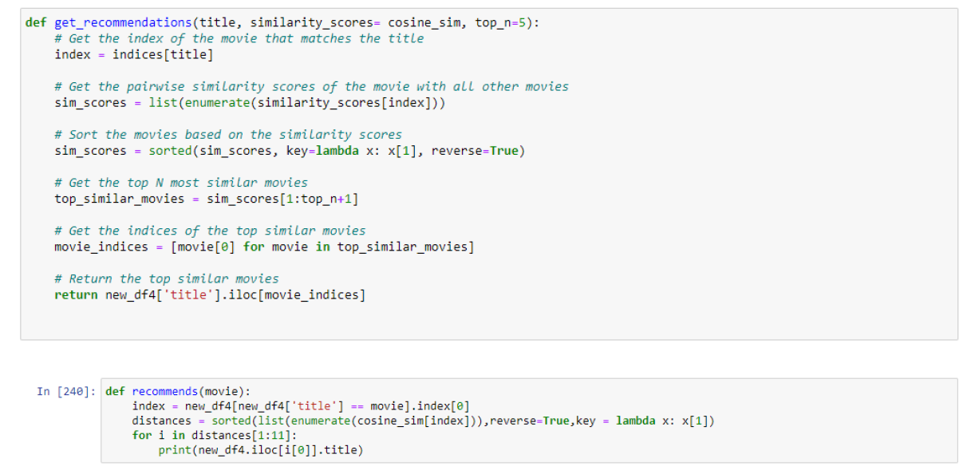
CODE SNIPPETS OF CONTENT BASED FILTERING

Slide 27
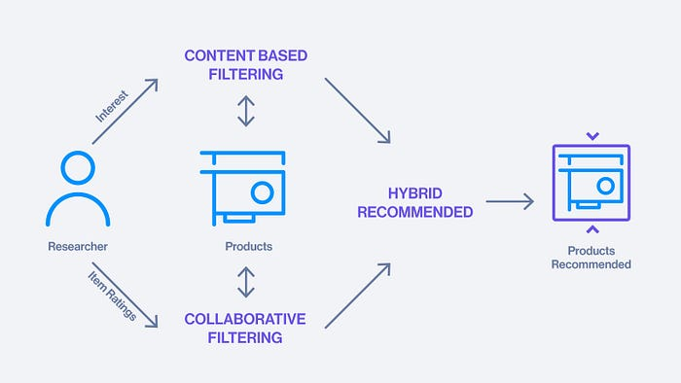
HYBRID FILTERING
Hybrid filtering utilizes both collaborative and content-based filtering, utilizing the advantages of each other.
Several studies comparing the performance of hybrid filtering systems with the collaborative and content systems alone have shown that hybrid systems have better accuracy.

Slide 28
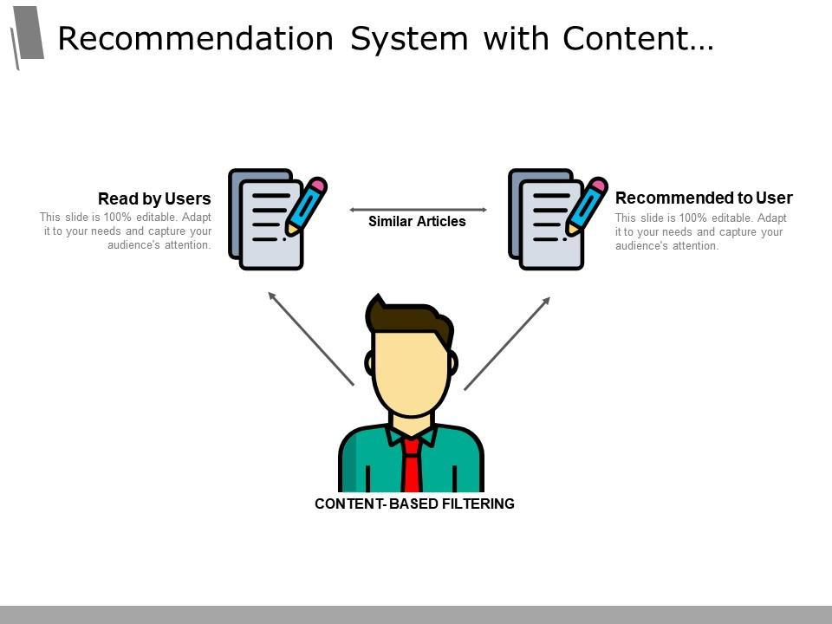
MODEL SELECTION
As we featured our data in the form of tags, so we go with content-based filtering

Slide 29
WHY WE CHOOSE CONTENT BASED FILTERING?
Content-based filtering enables personalized recommendations based on individual user preferences.
It can handle the cold-start problem by leveraging item attributes when there is limited or no user data. Recommendations are independent of user behavior or ratings, making it useful for new users
Content-based filtering offers transparency and explain ability in its recommendations, as they are based on item attributes. The use of item attributes makes it easier to explain why certain items are recommended to users.
It can provide diverse recommendations by considering various item attributes, allowing users to explore a wider range of items.
Content-based filtering is less influenced by trends or popularity bias because it focuses on the intrinsic attributes and characteristics of items rather than relying on user behavior or ratings., reducing the spillover effect.

Slide 30
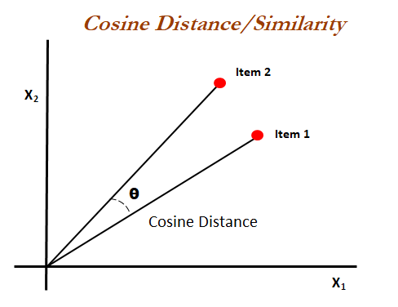
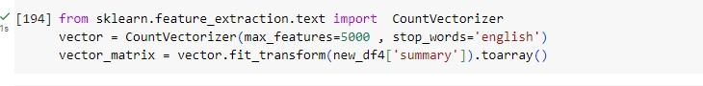
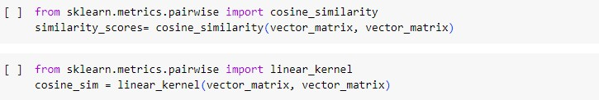
SIMILARITY SCORE CALCULATION
Similarity Calculation:
Compute the similarity between movies using a suitable similarity metric, such as cosine similarity, Jaccard similarity, or Euclidean distance.
Calculate the similarity scores between movies based on their feature vectors, allowing you to quantify how similar or related they are to each other.
We go with cosine similarity

Slide 31
RECOMMENDATION GENERATION
Build a recommendation engine that generates movie recommendations for users based on their preferences.
Utilize the selected recommendation algorithm, TF-IDF vectors, and similarity scores.
Implement personalized recommendations using collaborative or content-based filtering approaches.

Slide 32
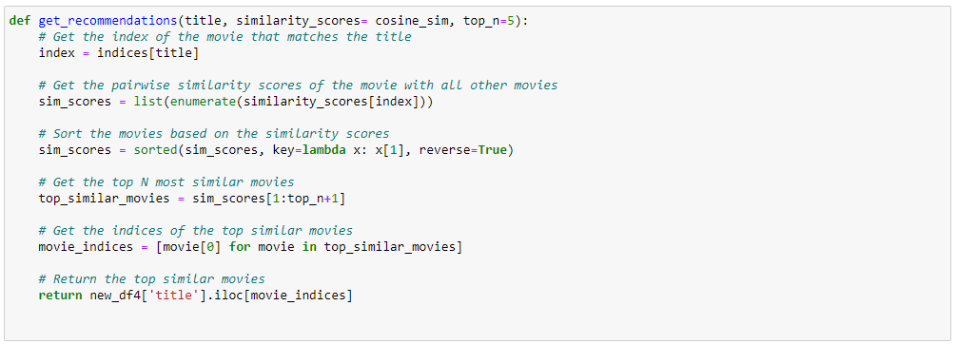
CODE SNIPPETS OF MODEL RECOMMENDATION

Slide 33
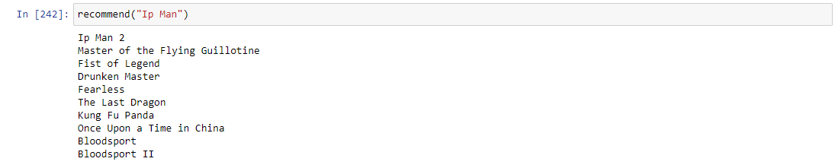
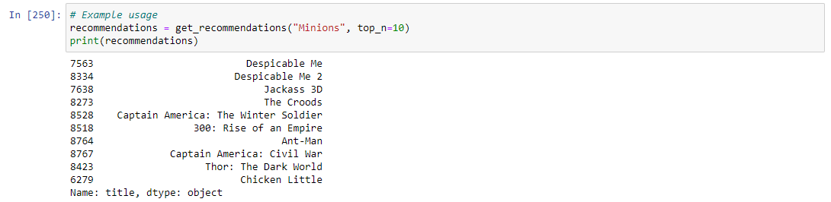
MOVIE RECOMMENDATION OUTPUT FOR “IP-MAN”
MOVIE RECOMMENDATION OUTPUT FOR “MINIONS”

Slide 34
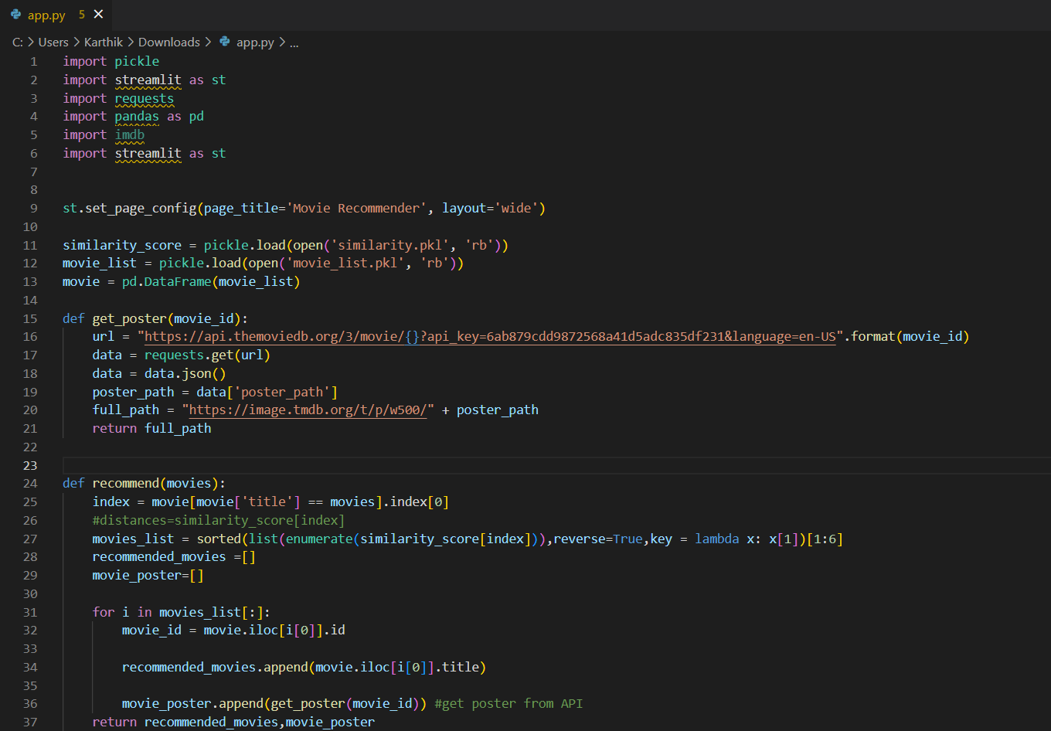
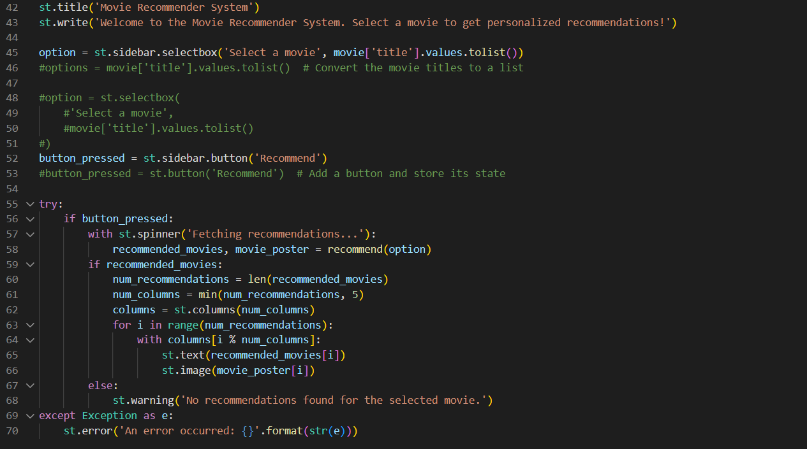
USER INTERFACE DEVELOPMENT
Using streamlit, create a web application that allows users to interact with the recommendation system. Include options for users to score films, submit feedback, and view personalised suggestions.
Ensure that the interface is user-friendly, responsive, and visually appealing.

Slide 35
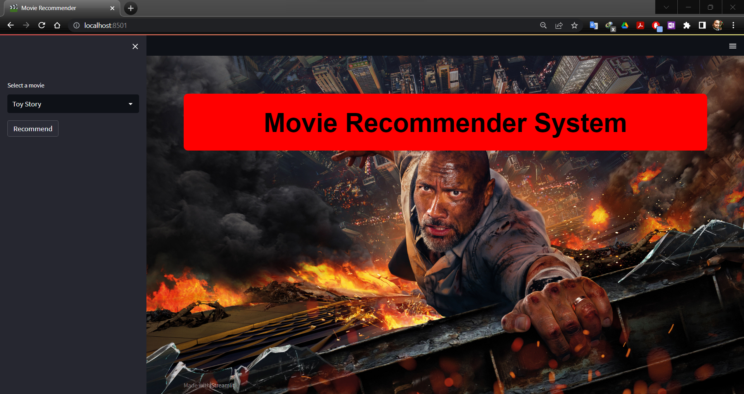
RECOMMENDATION WEB APPLICATION UI

Slide 36
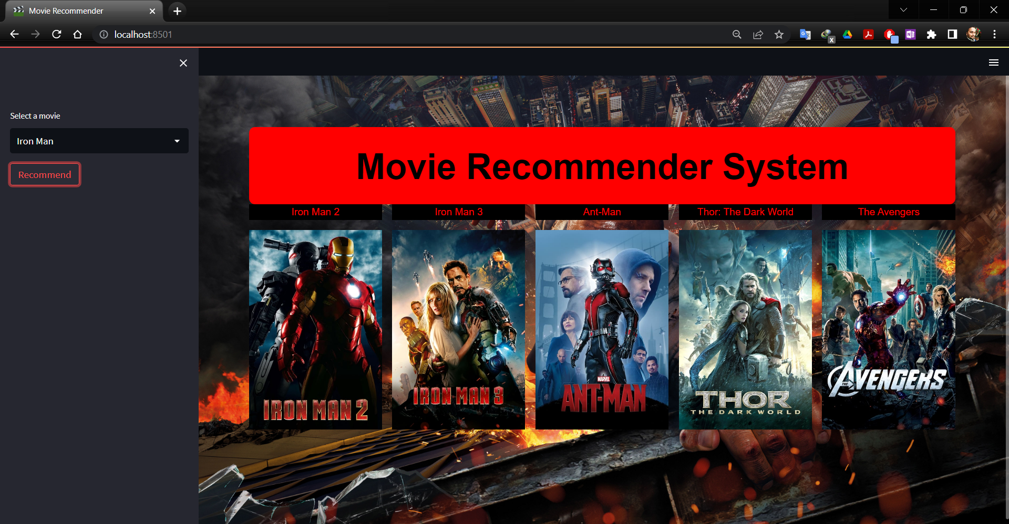
RECOMMENDATION FOR MOVIE “IRON MAN”

Slide 37
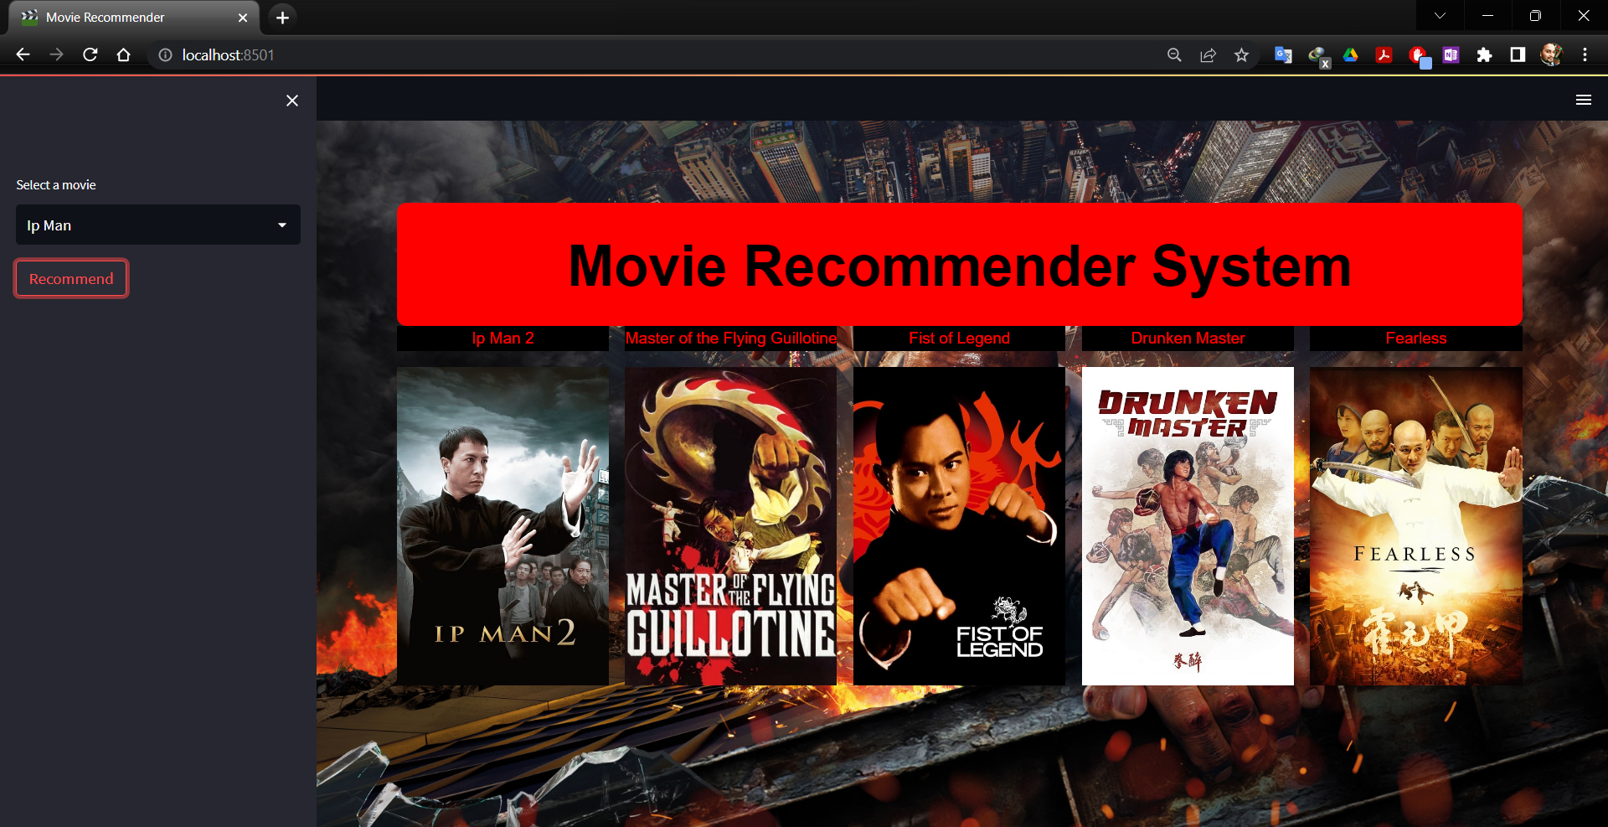
RECOMMENDATION FOR MOVIE “IP MAN”

Slide 38
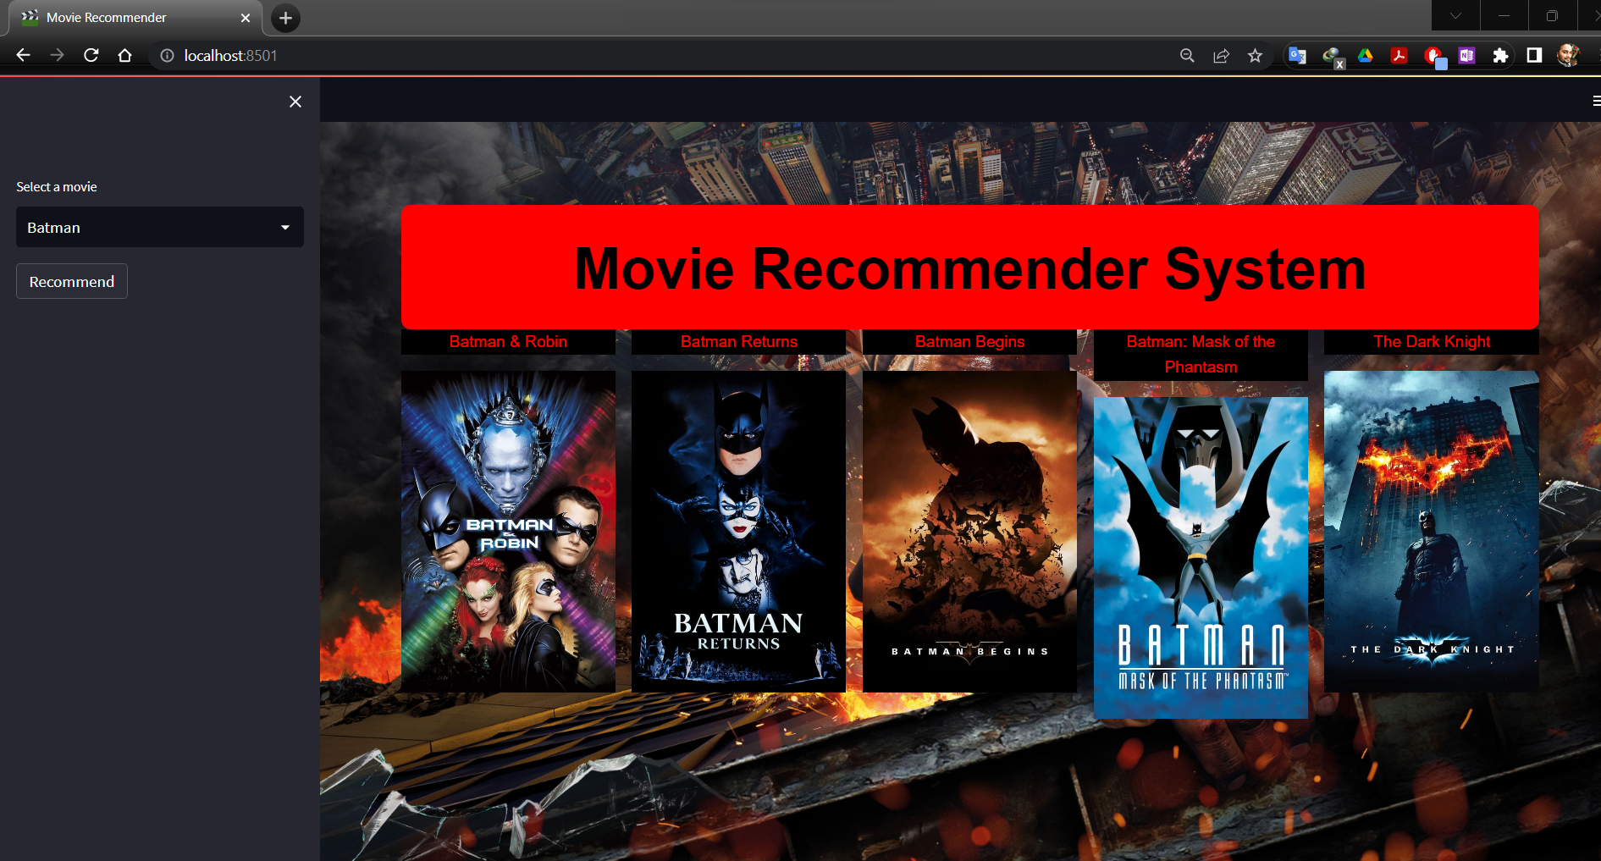
RECOMMENDATION FOR MOVIE “BATMAN”

Slide 39
MODEL DEPLOYMENT & TESTING
Deploy the movie recommender system on AWS.
Test the system's functionality, responsiveness, and performance.
Gather feedback from users and make necessary improvements.

Slide 40
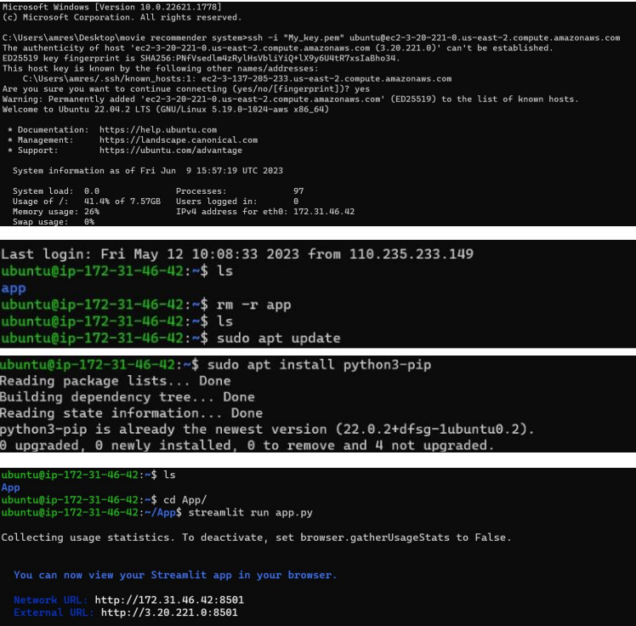
CODE SNIPPET OF AWS IMPLEMENTATION

Slide 41
CHALLENGES FACED IN THE PROJECT
Some columns contained mixed datatypes with categorical and datetime where the actual datatype is int64. It was handled by deleting the rows with datetime and was typecasted to integer.
While doing content-based filtering, due to large number of rows in the features column error was thrown which indicated lack of memory. Hence, we have used overview feature after doing all necessary preprocessing to allocate memory to run within the limits available.
While running the applications for some input values key value error and other types of errors have been raised. Initially it was a challenge to figure it out but later understood that some of the movie titles were same maybe some movies released with similar movie names in different years. All the duplicated values are dropped by which error was resolved.
In collaborative filtering, the outputs were the same for each user, resulting in a poor RSME score.

Slide 42
FUTURE SCOPE
Collect regular user feedback to improve the accuracy and relevance of the recommendation system.
Give recommendation with rating and review of movie
To provide up-to-date recommendations, the system should be updated on a regular basis with new movie releases, user preferences, and evolving algorithms. Monitor system performance and make necessary optimisations.
Collaborative filtering can be implemented
Deep learning techniques can be used to improve the accuracy of predictions of our model.
These techniques can be integrated with similar apps like YouTube, Spotify etc. to generate recommendations.

Slide 43

QUESTIONS???

